Slide 1
SBLAG Report
March 14

Slide 2
Time spent sharing out PLC Discussions

Slide 3
Culture = defines what it means to be normal
Culture = our box
“As we embrace SBLAG and build a new normal, we are creating a new box.”
Notes:
Cultures share beliefs, values, preferences, and goals. “The way we do things around here.”
Right now, we are trying to think outside of our current box or paradigm, if you will.
A change in culture is a slow evolution.
As we embrace Standards-Based Grading and build it to be our new normal, we are creating a new box.

Slide 4
Strong Box = Healthy Culture
Changing culture = fundamental change
Not just changing WHAT we do, but changing WHY WE DO IT.
Let’s build a strong box!
Notes:
Again, changing culture is slow.
One of the reasons is that when we change culture, we are changing a “fundamental”… not just changing what we do, but changing why we do it.
TO REPORT STUDENT LEARNING BASED ON ACHIEVEMENT

Slide 5
SBLAG Members
Winfair | Middle School | High School
Sarah Lowe | Missy Entriken | Jeff Huska
Carrie Anderson | Teri Malakowsky | Bryan Joyce
Sarah Mortwedt | Paula Wolter | Brad Schlomann
Melissa Pletcher | Katie Robillard | Lisa Letcher
Joni Garrison | Erin Elder | Devera Warner
Melissa Dardis

Slide 6
Why do we grade?
To reward? To report?
Grades are not about what students earn, they are about what students learn.
Notes:
Why do we grade?
To reward?
To report?

Slide 7
Grading Purpose Statement
The purpose of grading at Windom Area Schools is to communicate to students, parents, teachers, and administrators what each student knows and is able to do on grade and content level standards while separately assessing behavioral expectations.

Slide 8
When it comes to school culture…
…always trump the written rules.
Notes:
Building a strong box (culture) is important because we want the unwritten rules to match the written policy (grading purpose statement) .
Regardless of what policies may be written in a school’s handbook, it’s the cultural interpretation of those policies that determine how teachers will act.

Slide 9
Crucial Elements of Standards-Based Grading
Embrace explicit learning progression of standards to ensure a shared vision of what students should learn.
Develop a clear understanding of levels of knowledge so that all stakeholders share an understanding of what proficiency means.
Ensure transparency so that all stakeholders share an understanding of where students are on their learning progression.
Meaningful assessments with timely feedback so that students can continue to make progress.
Here’s where we are today.

Slide 10
4 Proficiency Levels?
“Four levels of performance is the most common number identified. Most educators consider three levels to be insufficient in discriminating important differences in students’ performance” (Guskey, 2014).
“A 4.0 scale has a high inter-rater reliability” (Wormeli, 2015).
“Earning 4’s should be achievable in the classroom…important that teachers’ lessons offer opportunities for students to excel and reach level 4” (O’Connor, 2012).
“The proficiency scale should identify content at the basic (2.0), proficient (3.0), and advanced (4.0) levels” (Marzano, 2009).
“The variety of scoring systems mostly use a scale of 0-4” (Sturgis, 2014).

Slide 11
Calibrating Proficiency – levels of knowledge
What does proficiency look like?
Our common language – Proficient = acceptable level of achievement for a learning standard
“Schools need to be clear and transparent about the level of performance that meets the bar.”
Calibration is where teachers come together with their standards, knowledge taxonomy, rubrics, examples of student work to discuss and fine-tune their understanding of what is expected of students at each learning target (Sturgis, 2014).
Notes:
Wayzata took away Skyward’s ability to do mathematical equations and teachers must use their PROFESSIONAL JUDGMENT.
The grade conversations center on the preponderance or pool of evidence of student performance in relation to “the bar.” Teachers are no longer absolved of responsibility by just “entering the points” and being done. They must defend the grade.

Slide 12
Ken O’Connor’s Proficiency Levels
4 = Excels
3 = Proficient
2 = Approaching Proficiency
1 = Well Below Proficiency or Not Yet

Slide 13
Platt Middle School in Boulder, CO
4 = Advanced Proficiency
3 = Proficiency
2 = Partial Proficiency
1 = Developing Proficiency
0 = Not Assessable

Slide 14
Virginia Beach Schools
4 = Advanced Proficient
3 = Proficient
2 = Developing Proficiency
1 = Novice

Slide 15
Wayzata, MN
4 = Distinguished
3 = Proficient
2 = Approaching
1 = Attempting
NA = Not Assessed
IE = Insufficient Evidence

Slide 16
Duluth, MN
4 = Mastering
3= Meeting
2 = Developing
1 = Beginning
NA = not assessed

Slide 17
SBLAG Decided….
4 Proficiency Levels
4 = Distinguished
3 = Proficient
2 = Developing
1 = Beginning

Slide 18
IMPORTANT!
4 = DISTINGUISHED
Meeting the standard at a
higher quality level

Slide 19
A 4 is NOT:
Not “EXCEEDS”
Not “ABOVE & BEYOND”

Slide 20
Time to calibrate…
What does proficiency look like?
Remember our common language:
Proficient = acceptable level of achievement for a learning standard (Entry Level Quality)
Proficiency is generally not linear and not specific to a moment in time = gray area
Professional Judgment
Notes:
Proficiency is generally not linear and generally not specific to a moment in time = GRAY area; professional judgment

Slide 21
Time to calibrate…
Calibrating knowledge levels = parceling out the degree of the standard’s verb
Gradations of the skill level: degree of competence; degree of mastery; the degree of proficiency;
Level of consistency
Amount of acceptable error
Remember: We can MEET the standard at different quality levels.
Notes:
Acceptable error: can play a piano piece at a 4-Excellent-Distinguished level – There’s more than likely going to be mistakes

Slide 22
Calibrating Verbs
Calculate – consistency; acceptable error
Analyze – quality differences of analyses
Infer – depth and quality differences

Slide 23
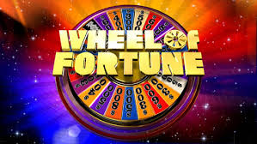
As you work to define these levels and terms…
Notes:
We can meet the standard at two different quality levels

Slide 24
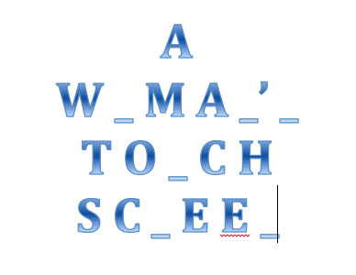
SOLVE THE PUZZLE
BEFORE AND AFTER

Slide 25
SOLVE THE PUZZLE
BEFORE AND AFTER
Level 1: Bergen Bar & Grill
Level 2: A Warrior’s Touch Screen (Partial)
Level 3: A Women’s Woman’s Touch Screen (Proficient – entry level – just made it – acceptable)
Level 4: A Woman’s Touch Screen (Distinguished)

Slide 26
How is this a 4?
What makes “solving the puzzle” distinguished?
Not about “above and beyond”
Not about exceeding
What is it about “solving” that can be calibrated?
Quality of confidence in answer
Fluency of the response
Less letters to work with
PROFESSIONAL JUDGMENT
Careful not to box yourself in to not being able to see it from different lenses

Slide 27
March 7th with Garnet: Behaviors
Brainstorm behaviors you want to “report out” apart from the standards-based achievement of a student.
Group those behaviors to alleviate the quantity of grades

Slide 28
Behaviors Out of the Grade
ISD #624--- Proficiency Levels 1-3
Responsibility
Engagement/Focus
Collaboration
Critical Thinking
ISD #742--- Proficiency Levels 1-3
Behavior Skills
Work Habits
ISD #284 --- Proficiency Levels 1-3
Behavior
Effort
Timeliness

Slide 29
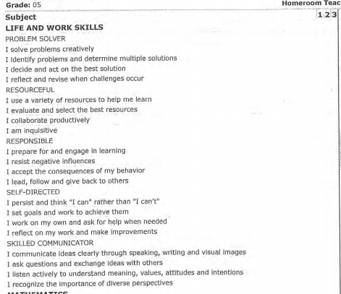
Osseo School District
Notes:
Osseo School District – lots of push back from teachers there to get rid of SBG
5 Life and Work Skills with 4 assessed areas under each = 20

Slide 30
Garnet Hillman on March 7th: Behaviors
3 = Consistently (not perfect)
2 = Sometimes (back & forth around halfway mark)
1 = Seldom
Eagle Pride Grades: Respect and Responsibility
Skyward: comments -- Bryan
Notes:
Remember the “why” = for student learning; reporting where students are at in their learning
Will always be “in process”
Reinforce our timeline of 2017-18 and Garnet dates

Slide 31
EAGLE PRIDE GRADES
PBIS MODEL
Respect for Self
Respect for Others
Respect for Environment
Be Responsible

Slide 32
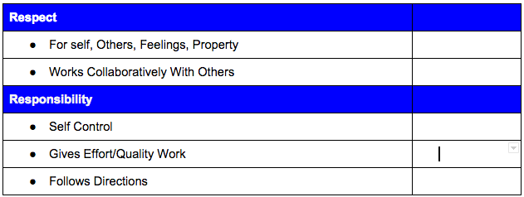
Winfair Eagle Pride Grades

Slide 33
MSHS Eagle Pride Grades
Respect_____
Responsibility_____

Slide 34
Garnet’s 6 Steps to Reach Our Goal
Analysis/Removal of behaviors/non-academics from grade
Determine Standards
Deconstruct Standards into Learning Targets
Standards Based Learning Experiences
Activities/projects
Formatives/Summatives = Practice/Game Time
Proficiency Scales
Communication and Reporting

Slide 35
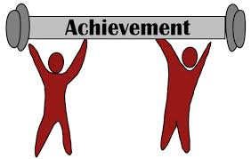
Non-Negotiables of SBLAG
Criterion Referenced = bar
Evidence Based
Academic Process Progress = SEPARATED
Achievement (behaviors) (growth)
Shortened Scale of Proficiency (4-6 levels)
More Feedback; Less Grading
Natural process of learning is honored
Notes:
Evidence Based = Student work based on the standard

Slide 36
Fourth Quarter
Comment box – comment on behaviors as you see fit
Sometime soon, PLCs will do an activity about what behaviors are sometimes included in a grade that we don’t want reflected in our achievement grade

Slide 37
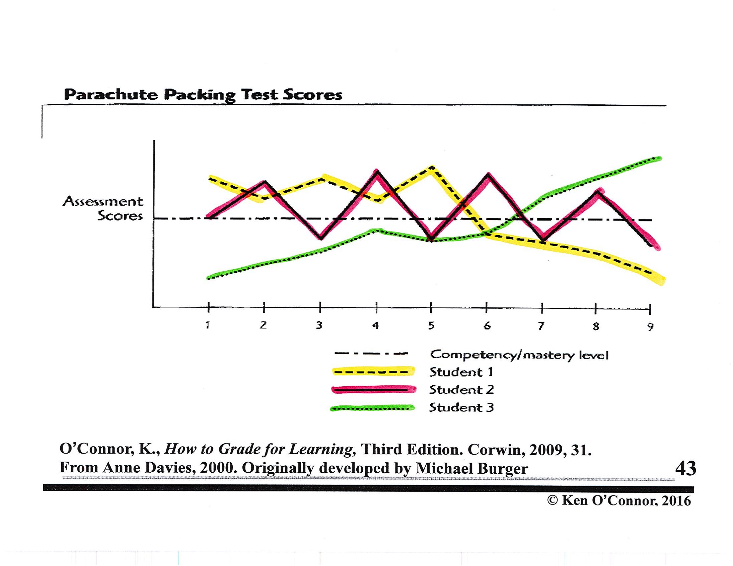

Slide 38
Expectations for Fall 2016
Behaviors/non-academic factors out of grade
Reported with 3-2-1 (Consistently, Sometimes, Seldom)
Rubrics will be developed

