Slide 1
Curriculum Maps
March 14, 2016

Slide 2
Curriculum Mapping
Summer Hours
Options:
Extend/Elaborate current reading map
Create a curriculum map for a different content area
Notes:
Working on developing a similar plan to what we had last summer. Not definitive amount of hours yet.

Slide 3
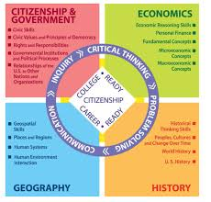
Bryan’s Social Studies Curriculum Map
https://goo.gl/hbQ6kq

Slide 4
Distinguished Curriculum Map
What is the purpose of the Curriculum Map?
Align content, assessments, & skills to standards
Formally examine & identify gaps
Collaboration structure that encourages common understandings across a district = program coherence
Share – facilitate knowledge
Ensures guaranteed, equitable, and viable curriculum for all students regardless of who is teaching the curriculum
Curriculum Maps are fluent – working/living documents to guide our daily work
They are meant to be changed!
Revise and improve!
“Having” the map is not the goal…..the process is the cornerstone.

Slide 5
Take it up a notch!
How do we take our curriculum maps to the next level?

Slide 6
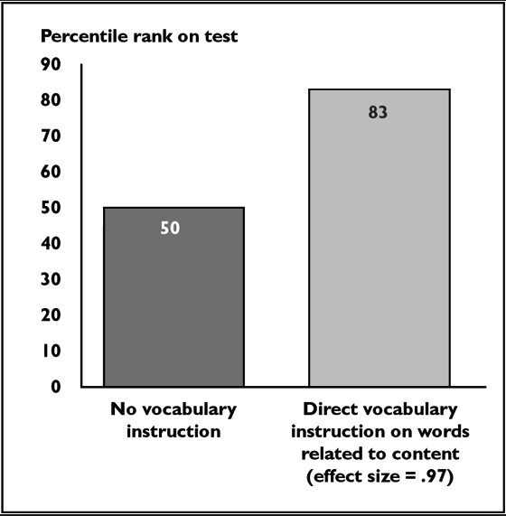
Academic Vocabulary
(Marzano, 2005)

Slide 8
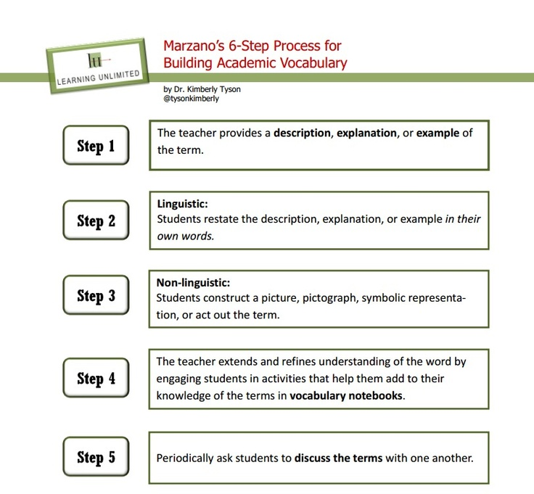

Slide 9
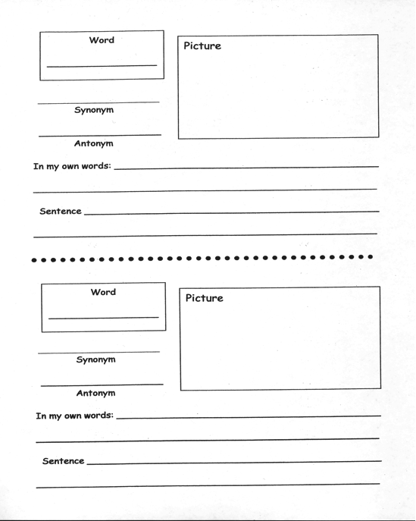

Slide 10
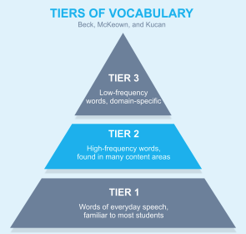
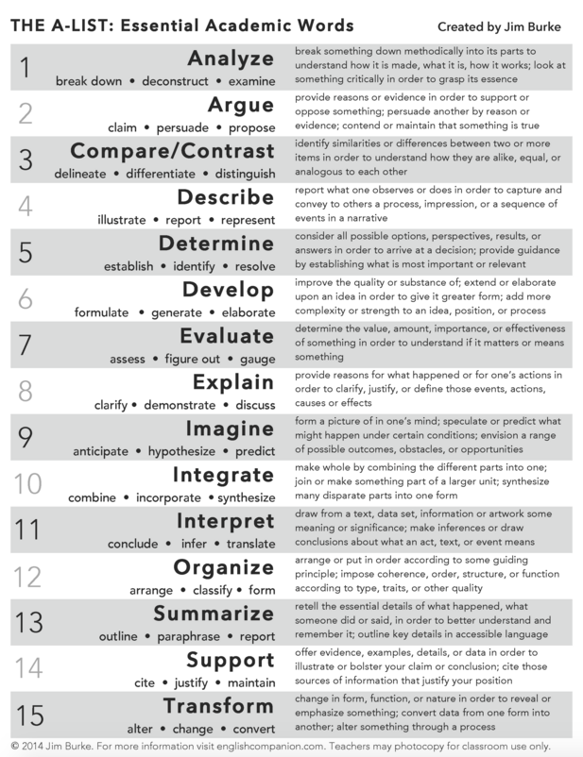
Tier 2 Example Words:
Tier 3 Example Words:
Biotic
Abiotic
photosynthesis

Slide 11
Add Formative and Summative Assessments
Not just worksheets, quizzes, and tests!
Anecdotal records
Book reviews
Checklists
Concerts
Conferences
Demonstrations
Diagrams
Dioramas
Essays
Exhibits
Games
Graphic organizers
In-class discussion
Interviews
Journals
Lab reports
Letters
Observations
Oral presentations
Performance Assessments
Posters
Projects
Reading response
Research
Running records
Speeches
Story maps
Tests
Worksheets
Notes:
Can also happen “on the fly,” but good formatives should be planned out ahead of time.

Slide 12
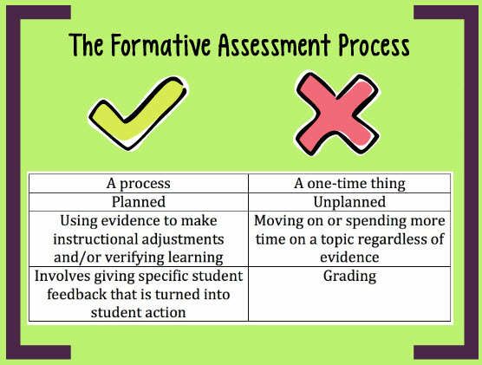
Formatives:
Notes:
Can also happen “on the fly,” but good formatives should be planned out ahead of time.

Slide 14
Formative and Summative Assessments
Remember: the verb drives the assessment!
If the verb is “apply” and our assessment has them “identifying” we have a mismatch.
Not aligned!

Slide 15
Add rubrics
Do I need a rubric for every standard?
NO!
Goal: the heavy hitters
Add links

Slide 16
Big Ideas or Themes
Enduring and Essential Understandings
Cuts to the core of the discipline
Broad in scope; fundamental for deep understanding of the subject
Enduring value beyond a single lesson
Examples:
Science: Scientific theories are used to explain the origin of the universe.
English: Writers use a variety of stylistic techniques to engage and persuade their readers.
Social Studies: Historical interpretation is influenced by one’s perspective.

Slide 17
Essential Questions
What provocative questions will foster inquiry, understanding and transfer of learning related to the “big ideas” and essential outcomes?
Open-ended
Arguable – and important to argue about!
Raise more questions – provoking and sustaining engaged inquiry

Slide 19
Add Resources and Activities to your map
What added resources do you have to teach a particular standard/benchmark that might be important to note?
Technology?
Books/additional reading/templates?
manipulatives or equipment?
What activities will be used?

Slide 20
Test Specs
MCAIII assesses a sampling – not every standard or benchmark is tested
Some can’t be assessed – but must still be taught!
Test Specifications indicate which strands, standards, and benchmarks will be assessed on the MCAIII and in what proportions.
Provide types of items included
Number of items
Distribution of cognitive levels
Clarify/define/limit how test items are written
Notes:
TEST SPECS FOR MATH WERE JUST UPDATED!!!

Slide 21
Where do I find test specs?
Two ways:
MDE or Windom.weebly.com
#1. MDE Breadcrumb:

Slide 22
#2.

Slide 24
If you are not an MCAIII grade level or state assessed content area….
Look at the next assessed grade level
Find a focus area to integrate: Standards for Literacy, Writing Across the Curriculum, etc.
Notes:
Science might look to informational text in the ELA standards or computation/algebra in math standards
Social studies might look to the Standards for Literacy (grades 6-12) in Social Studies, Science, and Technical Subjects.
These literacy standards describe how to read informational text, summarize, academic vocabulary, text features, purpose/pt of view, etc.

Slide 25
Distinguished Map Checklist:
Is the wording clear?
Are gaps identified?
Are learning targets in student-friendly language?
Aligned?
Vocabulary identified?
Resources and activities identified?
Rubrics accessible within the map?
Big Ideas/Essential Questions identified?
Test Spec information or integrated content included?
Formatives and Summatives – identified and variety of types

